Slide 1
Relationships
Kayla Kightlinger, Tori Wood, Rachel Snethen, Sarah Pinnell, Katelyn Kinney & Taylor Sullivan

Slide 2
Why are relationships important?
“ But one of the things that we never discuss or we rarely discuss is the value and importance of human connection. Relationships. James Comer says that no significant learning can occur without a significant relationship. George Washington Carver says all learning is understanding relationships.” (Pierson 2013)

Slide 3
Where do we see Relationships in education?
According to the ELA common core standards, in every grade!
“With prompting and support, describe the relationship between illustrations and the text in which they appear” Kindergarten Standard
“Describe the relationship between a series of historical events, scientific ideas or concepts, or steps in technical procedures in a text, using language that pertains to time, sequence, and cause/effect” Third Grade Standard
“Explain the relationships or interactions between two or more individuals, events, ideas, or concepts in a historical, scientific, or technical text based on specific information in the text.” Fifth Grade Standard

Slide 4
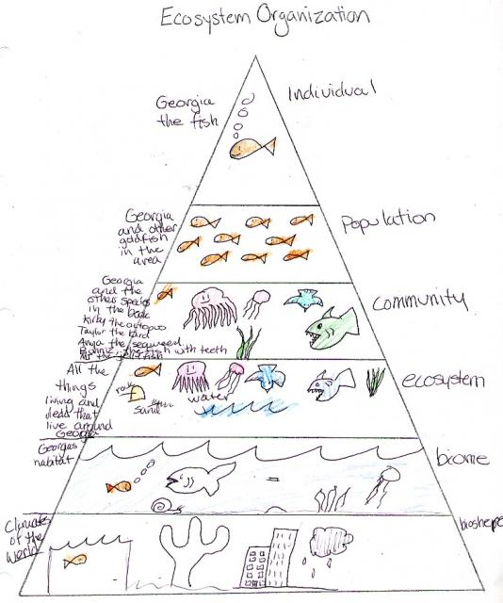
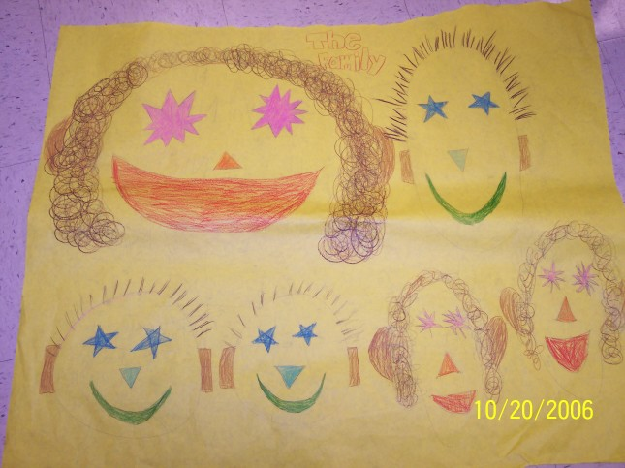
Relationships: Art & Science
-Have students draw an ecosystem pyramid to show the relationships between living things within an environment
-Explain to students about pedigree charts and have them create a family based on a pedigree chart

Slide 5
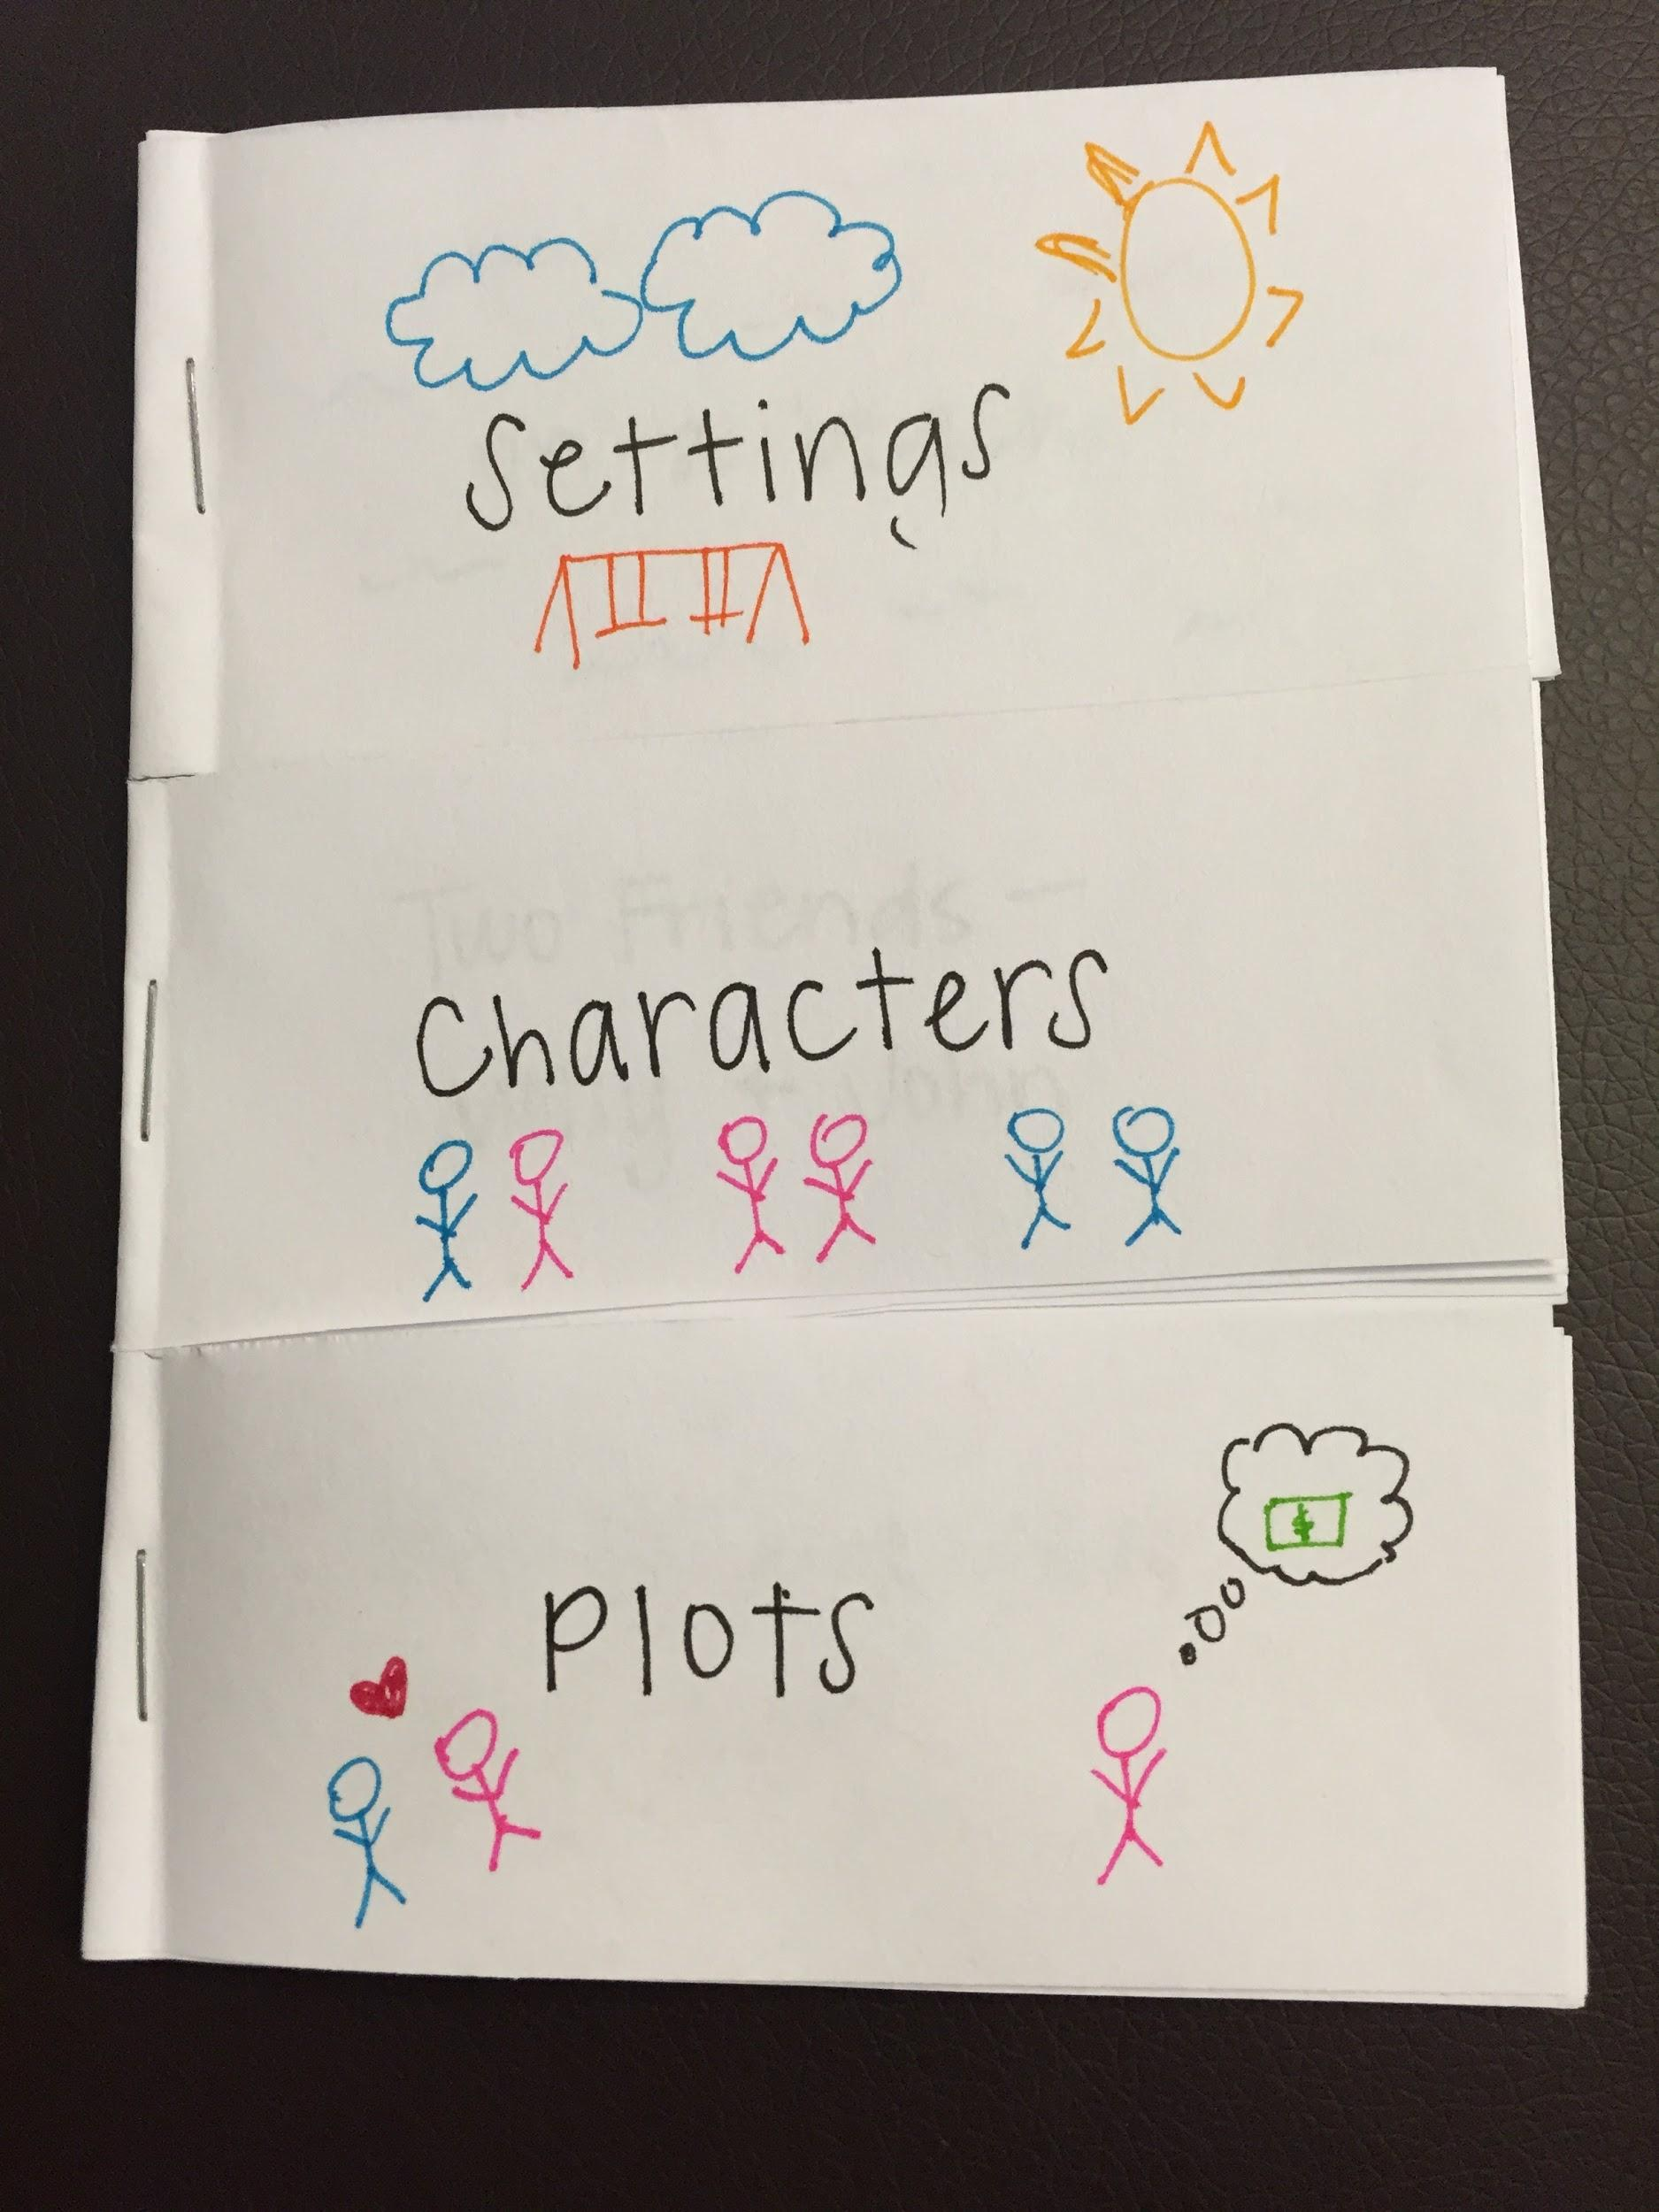
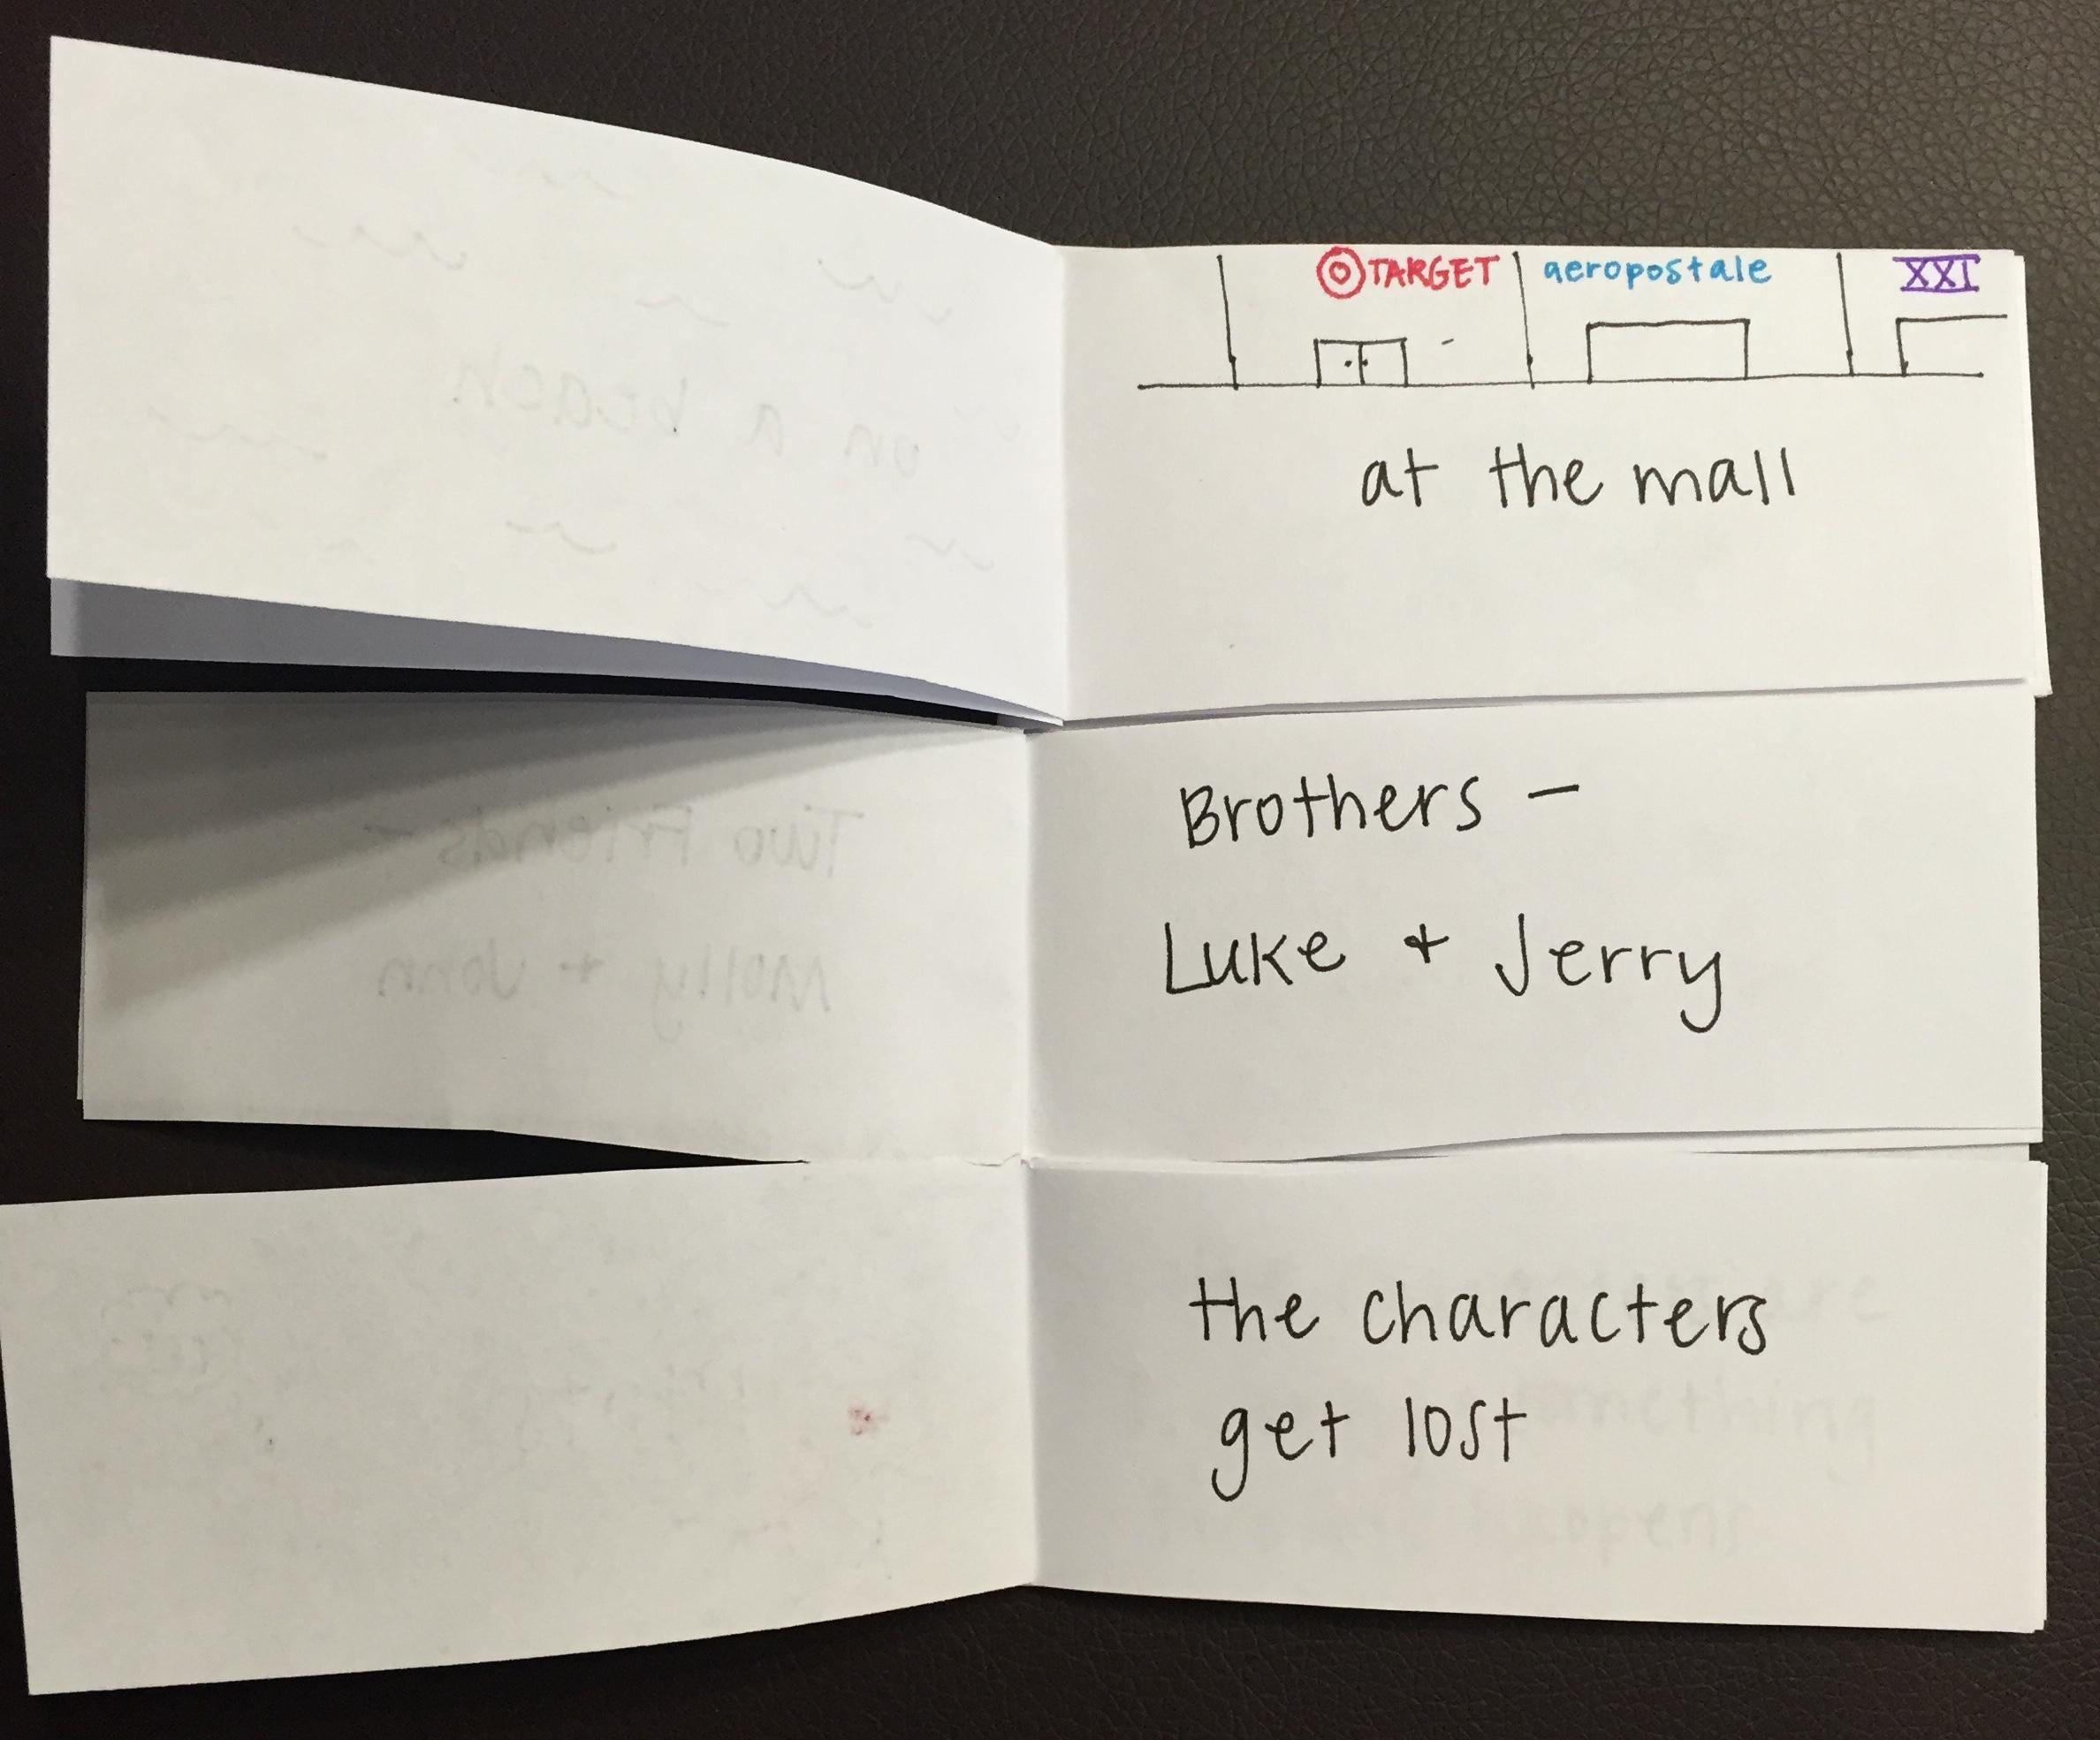
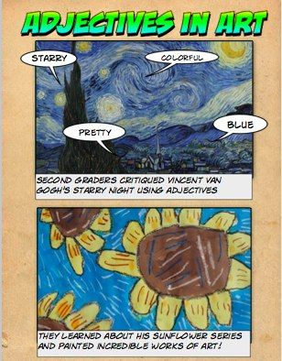
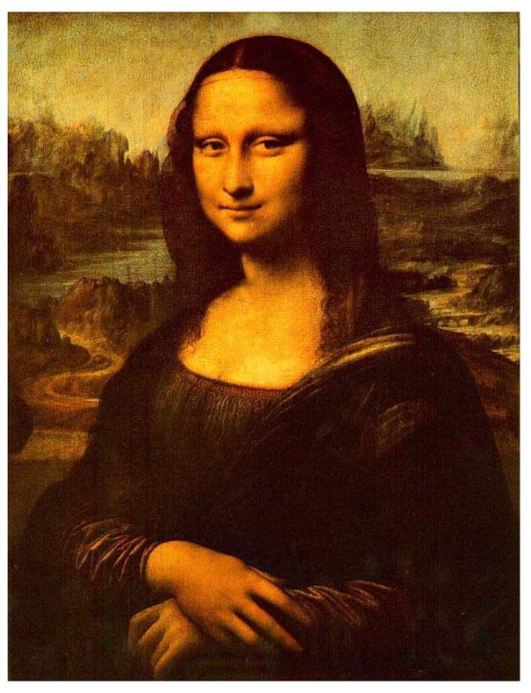
Relationships: Art & Language Arts
-Display various artworks and have students describe different parts of the work with adjectives. Afterwords, they could create their own work of art using adjectives they choose.
-Have students create a flipbook with
multiple options for settings, characters,
and plots. Talk about the relationship
between these components of a story and
how much the story changes when one of
these elements is changed.

Slide 6
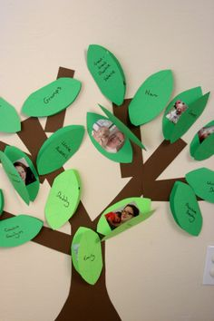
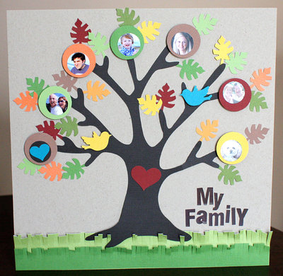
Relationships: aRt and Language Arts #2
-Students will do a family tree project that incorporates research skills and vocabulary.
-Have the students draw, or create the tree, and bring in pictures of the family on the tree up to a certain number of generations

Slide 7
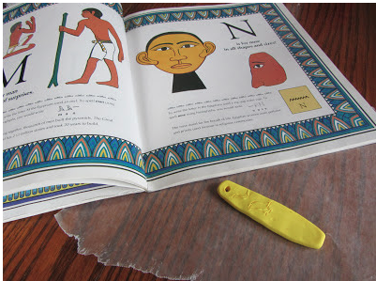
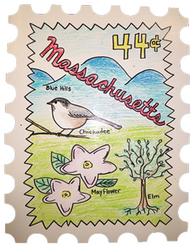
Relationships: art & Social Studies
-Students will be assigned one of the 50 states. They will be asked to design a stamp to go along with their state.
-The stamp should incorporate the relationship between the state and its symbols by drawing pictures.
-Students will use clay and pencil to write their name in hieroglyphics. They can compare/contrast the relationship of hieroglyphics to the English language today.

Slide 8
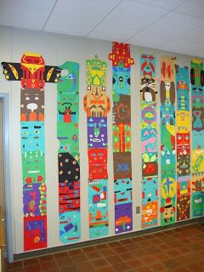
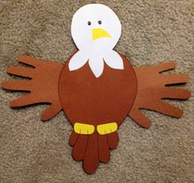
Relationships: Art & social studies #2
Tht
The students could make their own totem poles out of different colored paper and designs. The students can use different designs that represent part of their own culture or what they think totem poles used to look like. The students can talk about the relationship of the design of the totem poles and the culture of the Native Americans that made them.
The students can use this craft of a bald eagle and discuss the relationship of the symbolism of the bald eagle and America. They can also discuss why the bald eagle is so important to America.

Slide 9
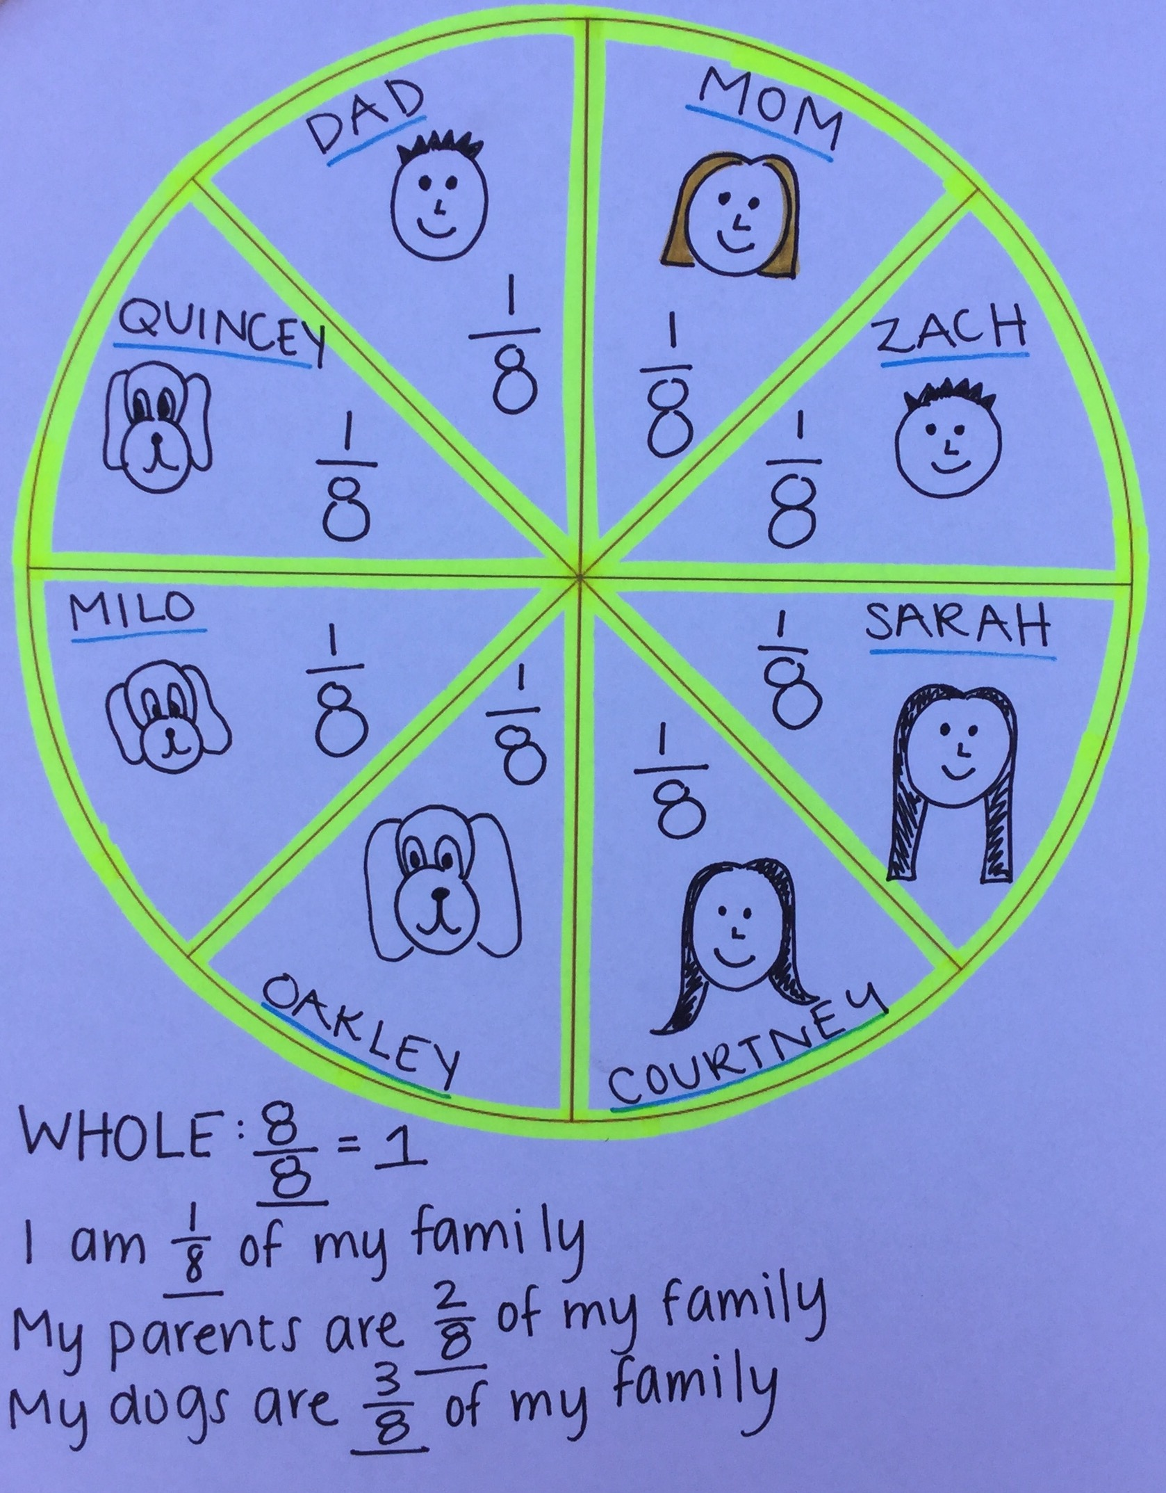
RELATIONSHIPS: ART AND MATH
Have students create a pie chart to represent their family.Students can talk about their family and determine and write different fractions within their family.They can also talk about different family relationships (ex. Siblings, parents, pets).

Slide 10
Citations
Common Core State Standards. S.l.: J Weston Walch Pub, 2011. Common Core. Common Core. Web. 20 Oct. 2015.
"Every Kid Needs a Champion." Rita Pierson:. TedTalk, May 2013. Web. 19 Oct. 2015.
"A Family Tree" www.teachervision.com/families/lesson-plan/3320
“Adjectives in Art” https://www.pinterest.com/pin/427842033325584331/

